Slide 1

Primary Care 2030:
White Paper on Transforming
Primary and Community-Based
Care
Meeting/stakeholder name
Presenter name, title, etc.

Slide 2
Primary Care Alliance (PCA)
Primary care representatives advocating for the advancement of primary care:
  Chair: Dr. Brad Bahler, Medical Director, PCN Evolution
  AMA Section of Family Medicine: Dr. Jon Hilner, SFM Member-at-Large
  AMA Section of Rural Medicine: Dr. Samantha Myhr, SRM President
  PCN Physician Leads' Executive: Dr. Jordan La Rue, PLE Co-chair
  AMA Board of Directors: Dr. Sadhana (Mindy) Gautama, AMA Board Member
  Alberta College of Family Physicians: Dr. Sudha Koppula, President and Ms. Terri Potter, Executive Director
  Department of Family Medicine (University of Calgary): Dr. Sonya Lee

Slide 3

Primary Care 2030
The Primary Care 2030 white paper describes a health system with an orientation towards primary care and community-based care that will generate:
  better patient outcomes
  better and more equitable access
  lower costs (in high-performing health systems, primary care accounts for one third to one half of total health expenditure)

Slide 4
What is driving the need for change
System Design
Siloed/fragmented system, result of misaligned funding and compensation models, inadequate coordination and continuity of care
System not driven by population and social determinants of health perspective
Acute/episodic hospital focus to the detriment of primary and community-focused approaches to care

Slide 5
What is driving the need for change
Performance and Adaptation
Workflows and how services are delivered not optimized, don’t reflect patient preferences
Inconsistent quality of care, limited standardization of clinical care pathways/protocols, insufficient uptake and support for quality improvement at the frontline
Insufficient measurement and accountability
Inadequate implementation and adoption of technology, including limited interoperability

Slide 6
What is driving the need for change
Leadership
Resistance to change at system/service levels among administrators and clinical disciplines
Inadequate community, patient and caregiver engagement and broadly representative governance
Lack of a shared, clear, co-created vision for the health system

Slide 7
Needs and expectations
Public wants a high performing, universal health system that meets their needs
Patients want their experience to be at the forefront of planning, design and service delivery
Alberta Health is concerned about the mismatch between per capita spending and expected out comes
Alberta Health Services are accountable to government and the public- overlap and confusion related to roles and responsibilities causes barriers to improvement
Health care professionals are not well integrated into teams and do not optimize their shared roles
Fee-for-service has hindered real change to integrated primary care

Slide 8

Opportunity
A new model, with the patient at the core, offers us the opportunity to realize benefits to all parties.
  To address the current and future needs of the patients, the medical community and government, transformational change is needed
  There are political, institutional and professional barriers that have historically challenged the scale of change that is required

Slide 9
Transforming Alberta’s health care system requires both a new system and a new service design.

Slide 10
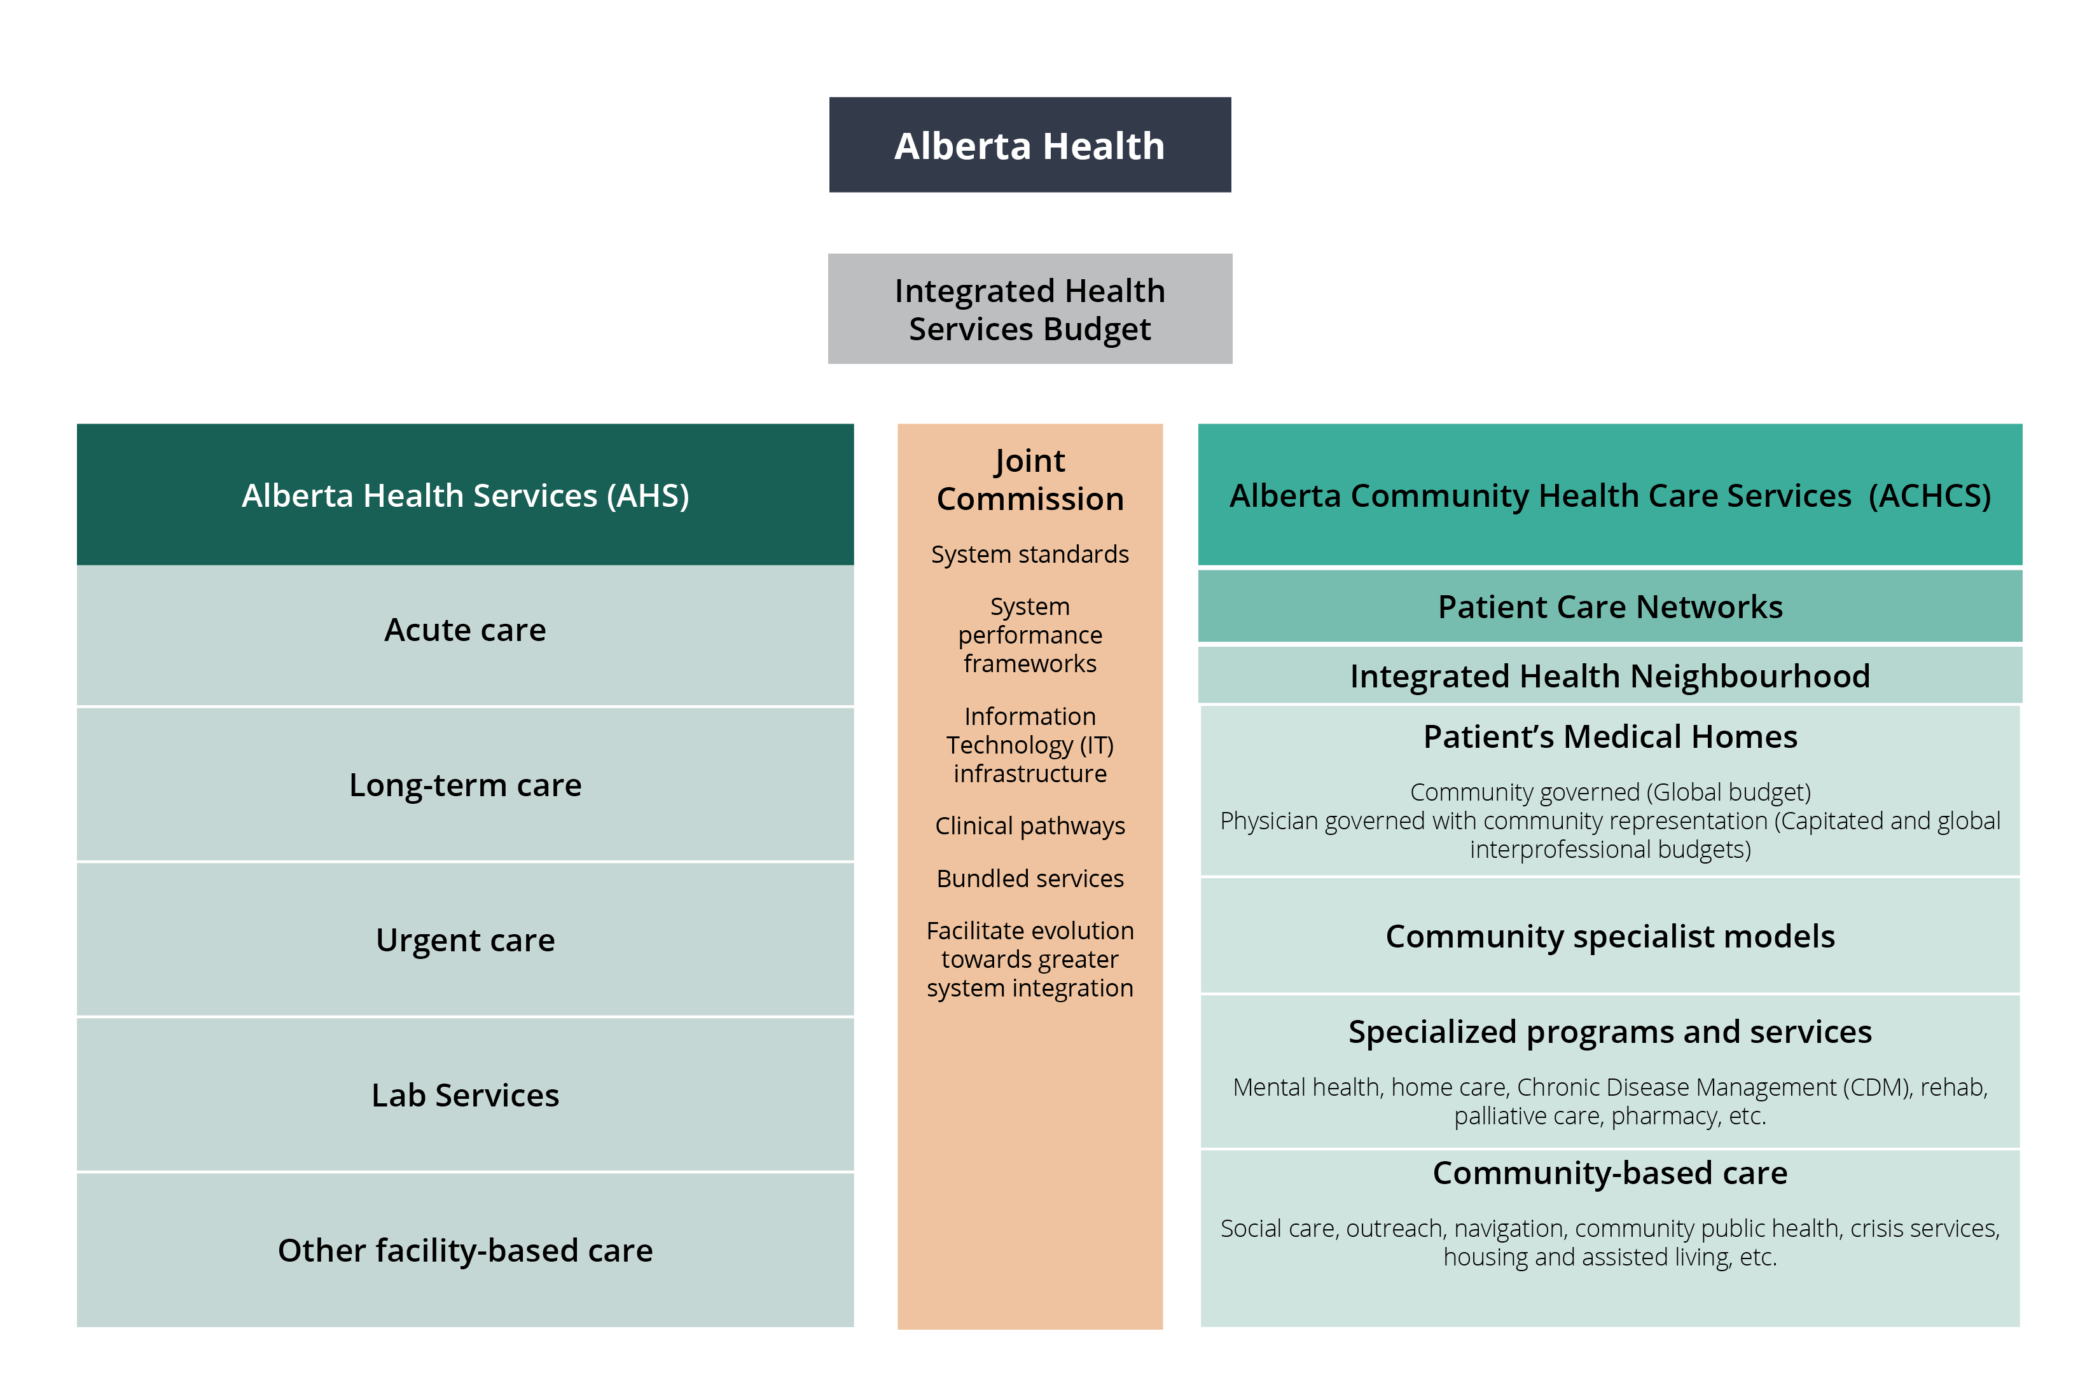
How we’ll get there
Evolve the organizational structures in the healthcare system
Changes are required to the existing provincial, regional and practice-based organizational structures.
An integrated funding, administrative and delivery system for primary and community-based health care services is needed.

Slide 11
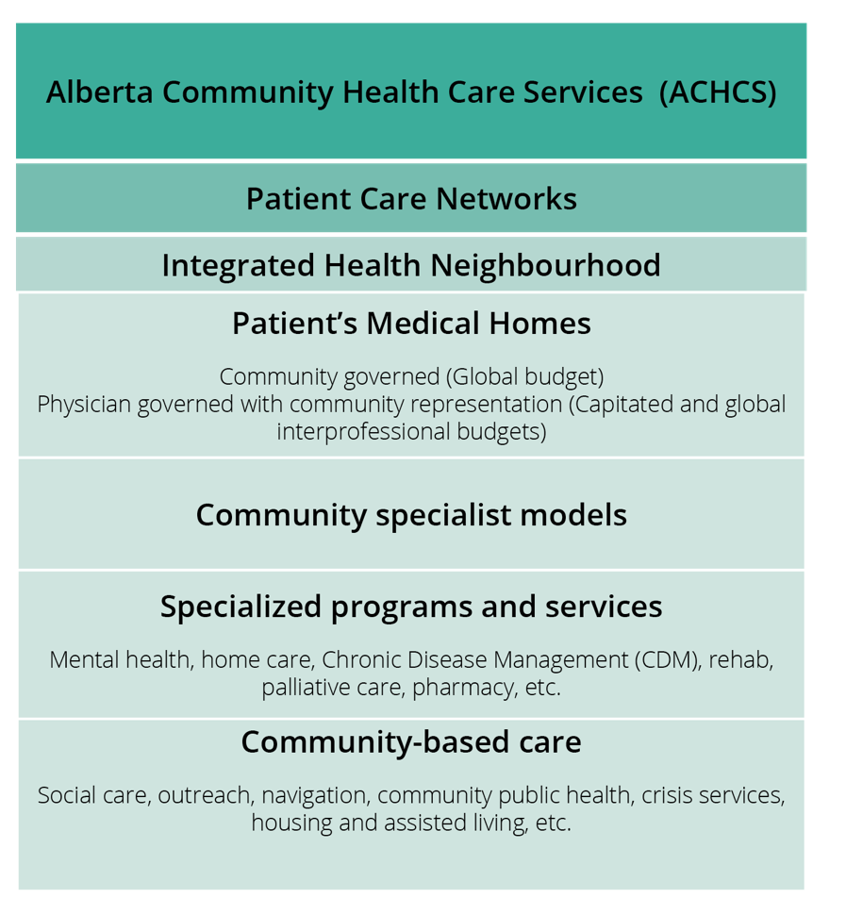
How we’ll get there
Alberta Community Health Care Services (ACHCS)
Oversight by a new provincial agency: Alberta Community
Health Care Services (ACHCS).
ACHCS will provide province-wide strategic leadership and planning
for community-based care within a global budget – including primary care, community specialists
and other community-based services

Slide 12
How we’ll get there
Patient Care Networks
Patient Care Networks will be responsible for planning, funding and oversight of all local community-based health services – Patient’s Medical Homes, community specialists, specialized programs and services and other community-based care.

Slide 13
How we’ll get there
Integrated Health Neighbourhood
The Integrated Health Neighbourhood features the Patient’s Medical Home as a hub, with care being integrated and coordinated within the neighbourhood among other local health services, specialists, hospitals and home care, and broader social and community supports.

Slide 14
How we’ll get there
Patient’s Medical Homes
Patient’s Medical Homes will be central to the integrated health neighbourhood. They will design services that reflect their patients’ needs and will have the flexibility to allocate their budget and deliver services in a way that meets those needs.

Slide 15
How we’ll get there
Community specialist models
Community specialists will share the budget and have joint accountability, along with the rest of the services within the Patient Care Network.
Instead of being funded through Alberta Health, they will be funded by and have contractual agreements with the Patient Care Networks and/or Patient’s Medical Homes.

Slide 16
How we’ll get there
Specialized programs
and services
The Patient Care Networks and services within the integrated health neighbourhood will work with other health services (e.g., acute and other facility-based care) to find ways to optimize communication, coordination and continuity of care.

Slide 17
How we’ll get there
Community-based Care
Community-based health and some social services will share the overall Patient Care Network budget (and accountability) with Patient’s Medical Homes and specialists.
Health professionals in the neighbourhood will serve one or multiple medical homes, funded either by the Patient Care Networks or Patient’s Medical Homes.

Slide 18
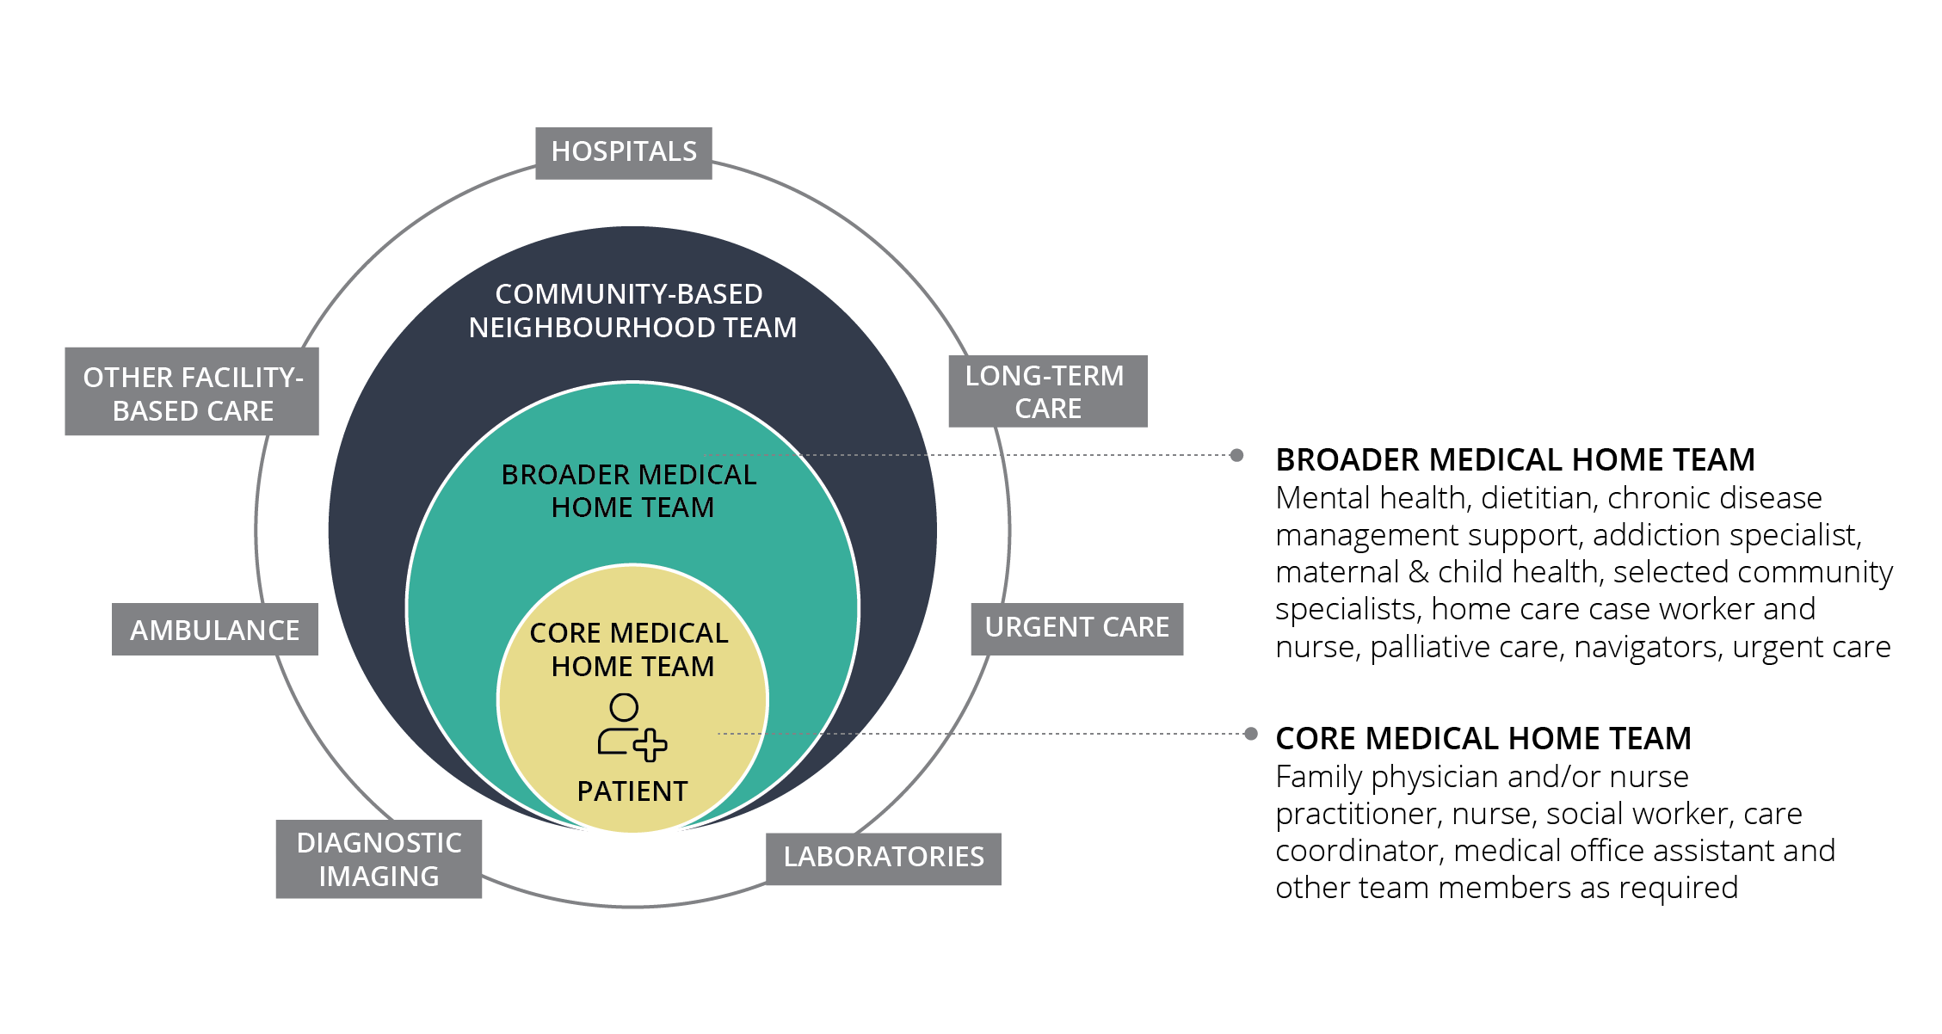
How we’ll get there
Orient systems for ongoing patient care around the Patient’s Medical Home/Integrated Health Neighborhood.
High-performing health systems are integrated, with streamlined funding and service delivery, and they are community and population health driven, with a primary care orientation.

Slide 19
Large-scale change is possible.

Slide 20
Alberta has made major progress in the last 20 years - and we can improve even more.
2020
Virtual Care takes off
‘19
Hospital To Home to
Hospital initiative
‘18
AMA partners with AHS and ACFP for Primary Care Opioid Initiative
Blended capitation pilot
‘17
Primary Care Integration Network formed
New governance model for PCNs
‘17
PCNs proliferate
AMA programs integrate
Specialty Care Alliance formed
‘13-15
Primary Care Evolution document released
Launch of PMH, panel management, Choosing Wisely, Change Agent Day & physician champion webinars
‘10-11
AMA develops a vision for primary care
PCA formed
‘02-08
AIM Alberta formed
PMP/TOP/ PCN PMO created
PLE, JVC & PCN Forum formed
Primary Care Networks launched
First PCNs operational
1999
Pilot projects in Taber & Crowfoot
New initiatives in Chinook & Calgary Health Regions

Slide 21
The Patient’s Medical Home will be the point of access to the health and social care systems for Albertans – a dedicated team of health professionals support them in accessing and navigating care to meet their health needs.

Slide 22
Patient-Preferred Pathways to Care
Patient’s Medical Homes
and integrated health neighbourhoods of the future will put patient needs and preferences at the forefront…
Social circumstances
Based on social and economic circumstances, population and risk group, risk factors, etc.
Delivery mode preferences
Single point of contact to access providers
Desirable service locations, environment and design
Same day access and at a time that suits the paties
Multi-model: in-person, telephone, video, group, portals
Personal preferences
Tailored to a diversity of culture, values, beliefs and perspectives
A tailored team
Access to a core and broader medical home team, as well as neighbourhood team
Access to preferred providers
Navigation and seamless care coordination supported by optimized technology
Family and caregiver roles play a major part
Care needs and preferences
Evidence based
Type and extent of intervention
Level of engagement in care decisions

Slide 23

The Patient’s Medical Home:
Situation Sample 1: Preventative Services
Kris visits her medical home with Jay for a well-baby visit with Jean, a nurse in her core team.
Jean examines Jay and also checks in on how Kris is doing. Kris is finding it more stressful than with her first two children and shows signs of postpartum depression. The family physician joins briefly to check on the baby, discuss Kris’ concerns and refer her to the mental health team member. Jean checks in with Kris by phone over the coming weeks.

Slide 24


The Patient’s Medical Home:
Situation Sample 2: Chronic Care
Sana was diagnosed with Type 2 diabetes after going to the clinic because she was feeling rundown.
Her core medical home team is a nurse practitioner, chronic care nurse and healthy lifestyle coach who work with Sana to develop a care plan around her goals. She attends most appointments virtually and accesses self-guided care, lifestyle coaching sessions, education and tailored research on her condition online. She takes her own vitals and enters them into the patient portal and monitors other test results online.

Slide 25

The Patient’s Medical Home:
Situation Sample 3: Specialist Integration
Dr. Chen is a community-based cardiologist who previously had a solo practice. He is now part of a group of specialists in the integrated health neighbourhood with a contractual agreement with the Patient Care Network. He also has a collaborative care agreement with a Patient’s Medical Home and is on-site part time.
As part of the broader medical home team, Dr. Chen works closely with several team members. He works with them to develop their capacity to manage cardiac patients and has supported the development of the clinical pathways. Dr. Chen joins the core team in a huddle when a patient is newly diagnosed with a heart condition and contributes to the care plan. A family physician or nurse practitioner, chronic care nurse and dietitian make up the core cardiac care team, and consult with Dr. Chen as needed, including via e-consults and messaging within the shared EMR. If the patient’s condition is complex or increases in severity, Dr. Chen takes an increasing role in the ongoing care.

Slide 26
Community-Based Care
In the future, health and social services in the community will be part of an integrated neighbourhood team. Services will be designed to ensure patients experience seamless transitions across different providers and care settings.

Slide 27

Community-Based Care: Situation Sample 1: Patient Experience
Sylvie, an older woman with multi-morbidities is not interested in videoconference appointments or researching her various health conditions. She wants a dedicated point person and to have “one-stop-shop” in-person appointments. She is grateful that her team helps her organize the various community supports she needs to stay in her home, as well as the increased social interaction she has with other women living on their own.

Slide 28

Community-Based Care: Situation Sample 2: Chronic Care
Benita has advanced congestive heart failure. Her care is formally shared and coordinated among the broader Patient’s Medical Home team, home care, the cardiologist, the cardiac care centre, a palliative care team and a dedicated care coordinator.
Benita’s tailored care plan reflects her wish for Minimally Disruptive Medicine. Office visits are minimized because there is ongoing home monitoring and virtual care.

Slide 29
Patient Experience in a Social Determinants and Population Health-Driven System
The new health system structure will help to improve the health status of Albertans by addressing the interrelated conditions and factors that affect health.
Attention will be given to health equity, social justice, human rights and the most vulnerable – a broader focus on the moral determinants of health.

Slide 30
And the system we’re proposing is designed to measure, learn and adapt.

Slide 31
What’s in it for everyone?
Family Physician Specialists: primary care is set up as foundation of the health care system
Specialists: referral flow in and out of primary/community care would result in better, more coordinated patient care – may take some burden off their shoulders
Government: saves money in the long run, political win as health care is always top of mind and it would benefit government to be seen as visionary/longer term thinkers who are willing to work with partners
Public: better health outcomes, continuity of care, integration system that puts the patient at the center, less risk of people ‘falling through the cracks’

Slide 32
Consultation Phases: from White Paper to collaborative action
PHASE 1 – Primary Care 2030 White Paper development
  PCA members provide thought leadership
  Robust review and synthesis of evidence from high performing primary care systems across the globe
  Options and recommendations shared using info gathered + knowledge of Alberta context
PHASE 2 – Stakeholder engagement
  Consultation with thought leaders, content experts, academics, system engineers, patients and key organizations
  Draft White Paper used to start the conversation and consultation with key stakeholders
  Stakeholder input incorporated to further shape White Paper and commitment
PHASE 3 – Establishing commitment and action
  Strategic commitment and structures determined by key stakeholders to advance primary care transformation
We are here

Slide 33
Conclusion
Alberta’s health care system is faced with multiple challenges – these will require a concerted, bold response
The Primary Care 2030 white paper challenges partners to a) work together and b) challenge the status quo
It proposes significant changes to ensure a future system that is:
  primary and community-based care oriented
  population health driven
  seamlessly integrated
  team-centered
  technology and innovation supported
  focused on (and accountable to) values and outcomes that are important to patients

Slide 34
It is time to push through political, institutional and professional barriers and work together create a system that benefits all Albertans.

Slide 35
Thank you

