Slide 1

Primary Care 2030:
White Paper on Transforming
Primary and Community-Based
Care
Meeting/stakeholder name
Presenter name, title, etc.

Slide 2
Transforming Alberta’s health care system requires both a new system and a new service design.

Slide 3
Large-scale change is possible.

Slide 4
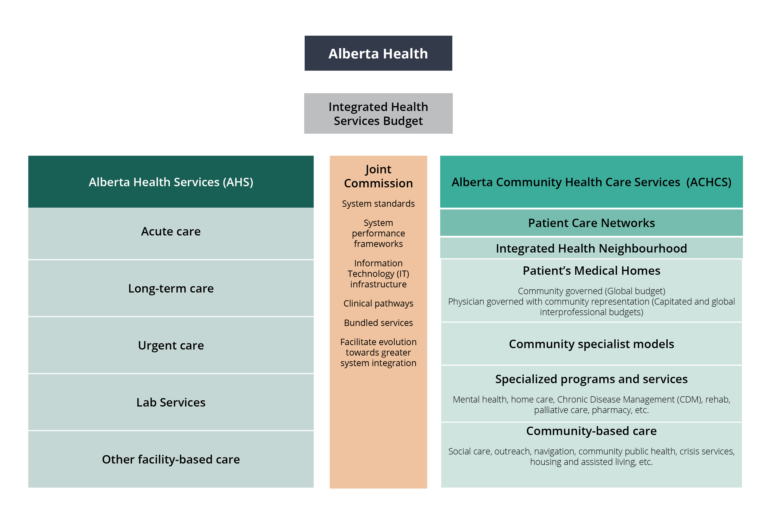
How we’ll get there
Evolve the organizational structures in the healthcare system
Changes are required to the existing provincial, regional and practice-based organizational structures.
An integrated funding, administrative and delivery system for primary and community-based health care services is needed.

Slide 5
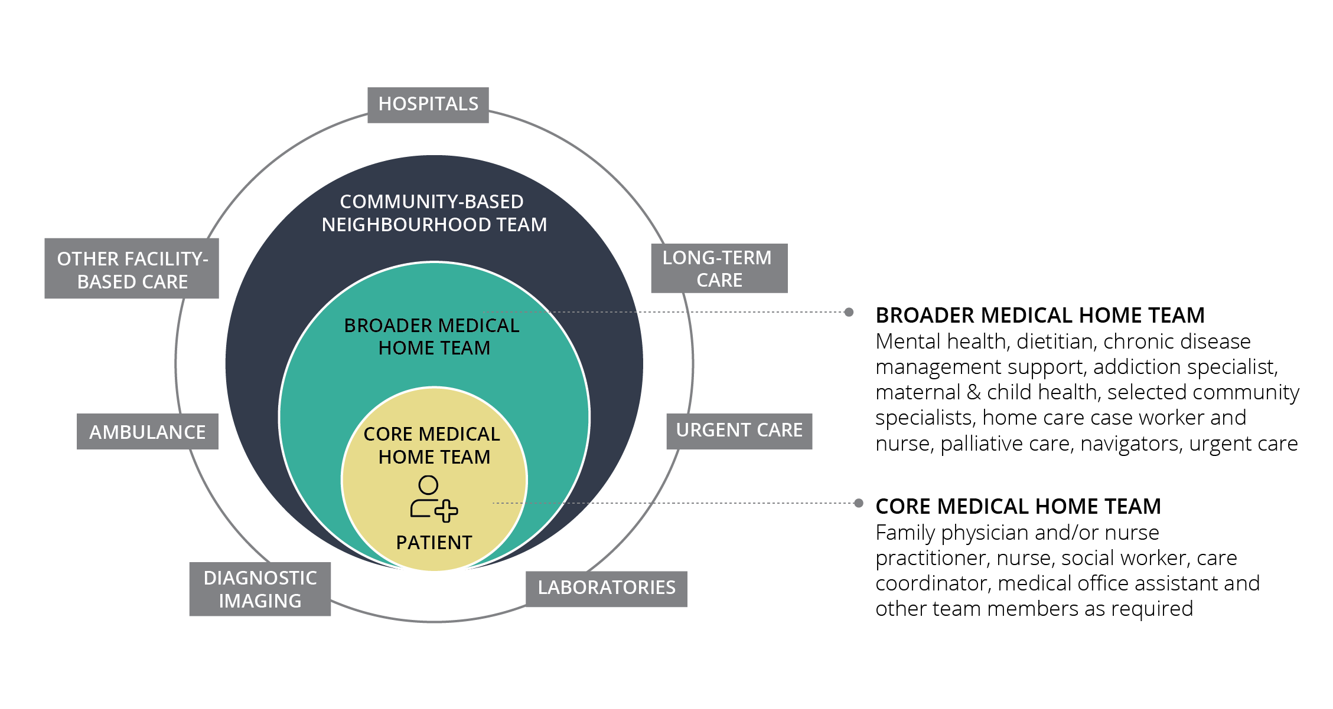
How we’ll get there
Orient systems for ongoing patient care around the Patient’s Medical Home/Integrated Health Neighborhood.
High-performing health systems are integrated, with streamlined funding and service delivery, and they are community and population health driven, with a primary care orientation.

Slide 6
The Patient’s Medical Home will be the point of access to the health and social care systems for Albertans – a dedicated team of health professionals support them in accessing and navigating care to meet their health needs.

Slide 7
Community-Based Care
In the future, health and social services in the community will be part of an integrated neighbourhood team. Services will be designed to ensure patients experience seamless transitions across different providers and care settings.

Slide 8
Patient Experience in a Social Determinants and Population Health-Driven System
The new health system structure will help to improve the health status of Albertans by addressing the interrelated conditions and factors that affect health.
Attention will be given to health equity, social justice, human rights and the most vulnerable – a broader focus on the moral determinants of health.

Slide 9
And the system we’re proposing is designed to measure, learn and adapt.

Slide 10
It is time to push through political, institutional and professional barriers and work together create a system that benefits all Albertans.

