Slide 1

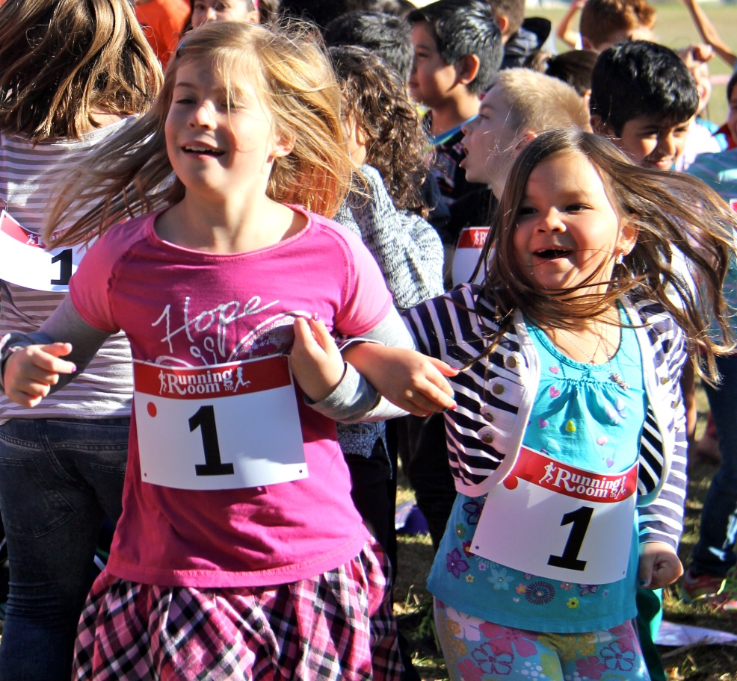
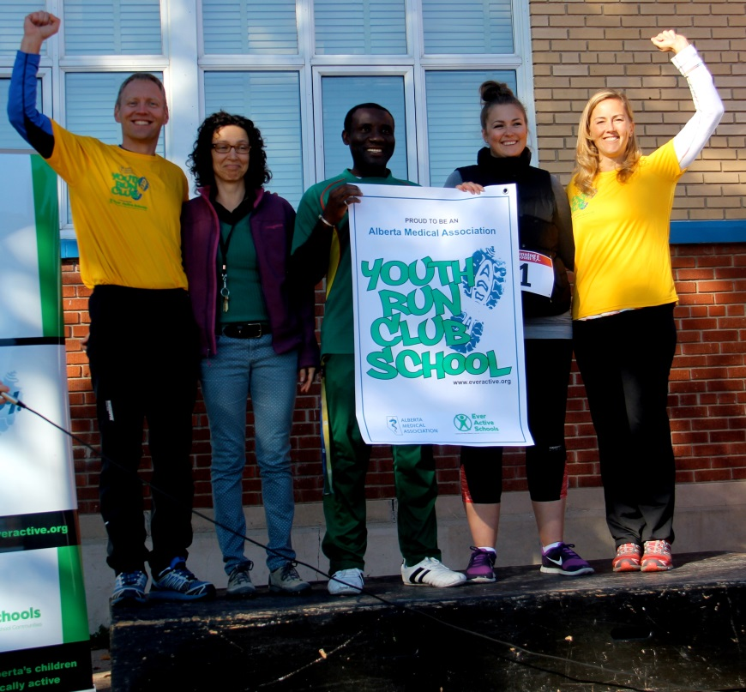
AMA Youth Run Club
School health advocacy:
Developing CANMEDS competencies

Slide 2
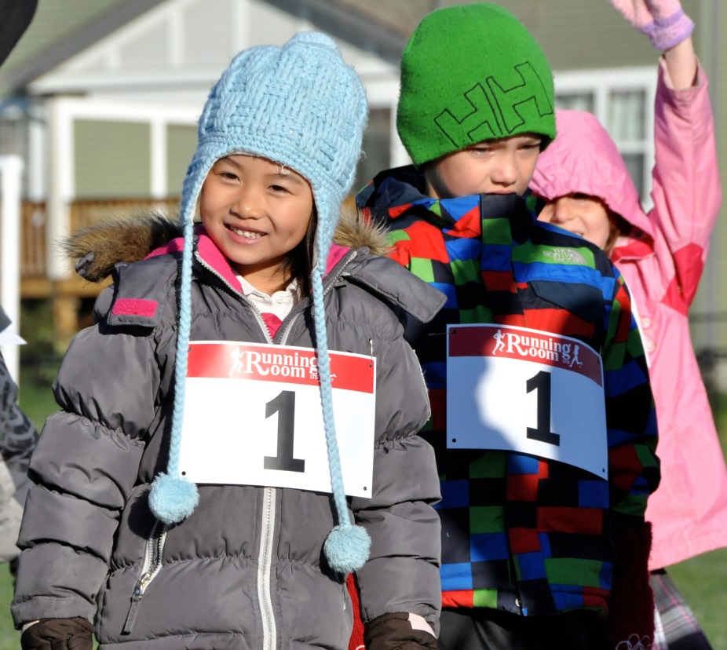
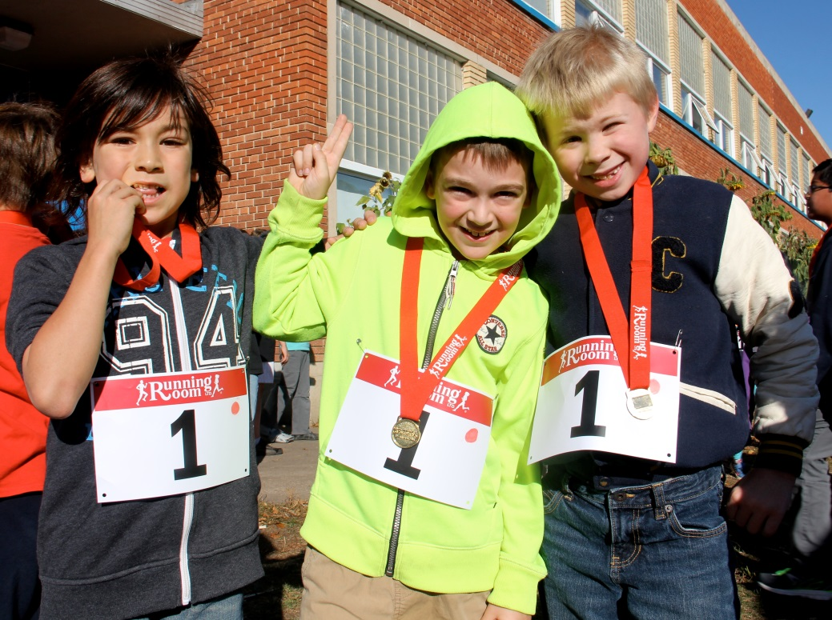
AMA Youth Run Club
What is Comprehensive School Health? How is it supported by the AMA Youth Run Club? View the CSH/YRC video on the AMA website

Slide 3


AMA Youth Run Club
Since 2013, a partnership of the Alberta Medical Association and Ever Active Schools
THEN: 74 schools and approximately 4,000 students (primarily elementary)
NOW (2017-18 fall/winter season): 455 schools and approx. 27,000 students
GOAL (2016-17 school year): 500 schools, 30,000 students

Slide 4
AMA Youth Run Club
Mission
Through the AMA YRC, physicians, medical students and residents can meet with the children, teachers and families of their communities to encourage physical activity and healthful living.

Slide 5
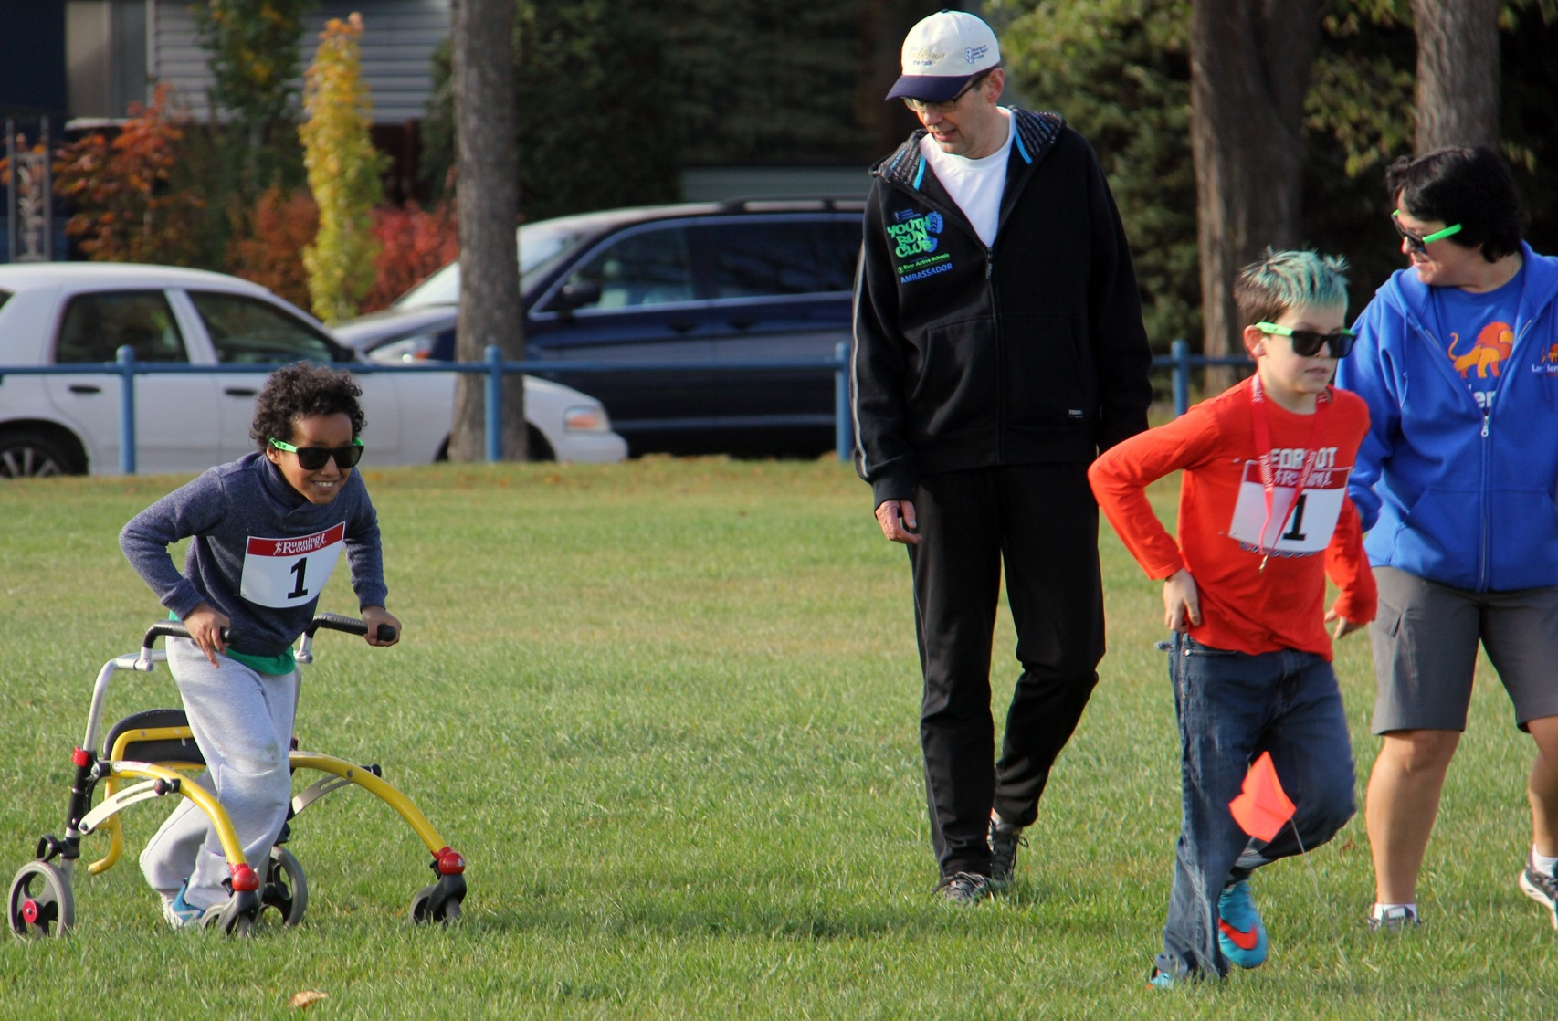
AMA Youth Run Club

Slide 6
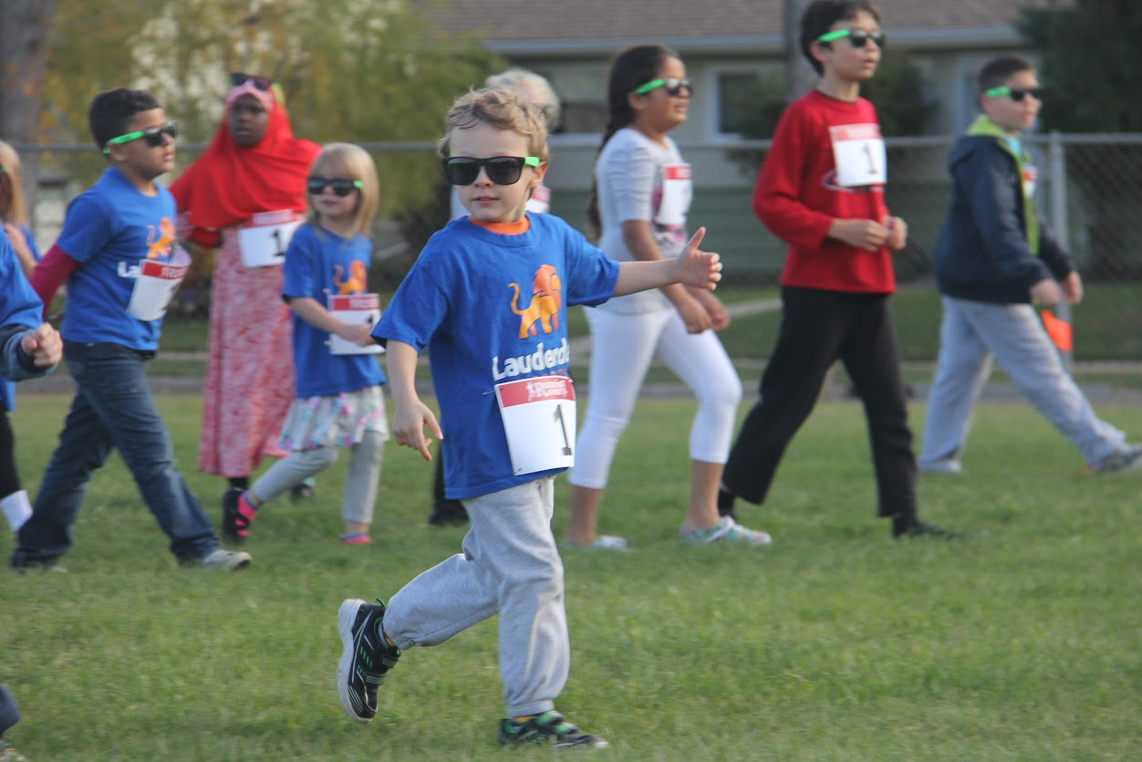
AMA Youth Run Club

Slide 7
AMA Youth Run Club
Program Goals
Increase levels of physical activity in school-age children and youth.

Slide 8
AMA Youth Run Club
(from the) 2015 ParticipACTION Report Card on Physical Activity for Children and Youth:
Health Professionals: Be influential. Promote every child’s connection with nature and the outdoors – identify outdoor play resources and partner with municipalities, parks, nature-related organizations, parent groups and children to support this process.

Slide 9
AMA Youth Run Club
Program Goals
Develop life-long healthy lifestyle habits and decrease screen time among
school-age children and youth.

Slide 10
AMA Youth Run Club
(from the) 2015 ParticipACTION Report Card on Physical Activity for Children and Youth:
Only 9% of children age 5-17 meet the guidelines for their age group of 60 minutes of moderate-to-vigorous-intensity activity per day.

Slide 11
AMA Youth Run Club
Program Goals
Develop youth leaders and CHAMPions to help sustain the program.
Educate: Building the foundations of life-long good health habits: physical (exercise, nutrition) and mental.
Expand the program; maximize capacity at the school/club level.

Slide 12


AMA Youth Run Club
40-50% more physical activity in YRC youth
+ 18-20 mins/day vs
Alberta
+ 21 mins/day vs
Canada
Notes:
What did we find? Youth in the AMA run club achieve an additional 20 minutes of MVPA daily, compared to youth studied in the Healthy Hearts cohort between 2008 and 2010. They also achieve an additional 20 minutes daily compared to a population-based sample of similar aged children from across Canada.

Slide 13
AMA Youth Run Club
In addition to partners (AMA and EAS) the YRC is supported by:
YRC CHAMPions: AMA Physicians, medical students, residents
Ambassadors: Paula Findlay, Tim Berrett, Martin Parnell
Sponsors: Alberta Blue Cross (gold level); MD Financial Management (bronze level)

Slide 14
AMA Youth Run Club
What does a YRC CHAMPion do?
Visit a YRC school and deliver a school health advocacy talk
Run with a club; help coach/lead
Work with school administration/council to start a club
Incorporate the YRC into a PCN community engagement plan

Slide 15
AMA Youth Run Club
School Health Advocacy Talks
7 talk tip sheets on the AMA website:
Sweet dreams: Sleep keeps you healthy
Screen time
Physical activity: It’s good for you
Running: Good for your mind, too
Activity-related nutrition
Sun safety
Run, run for fun…without injuries

Slide 16
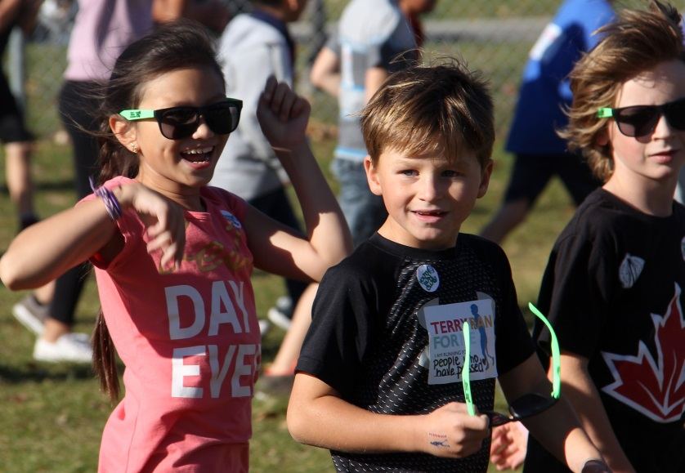
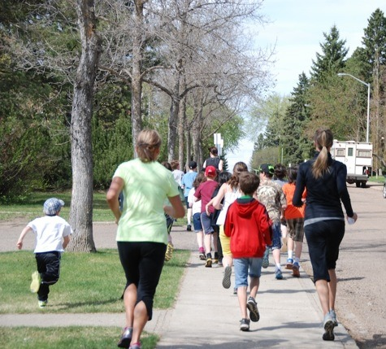
AMA Youth Run Club
YRC CHAMPions
Physicians
Medical students
Residents
engage
promote
support
encourage
BE a role model.
LIVE the mental and physical benefits of a healthy lifestyle.

Slide 17
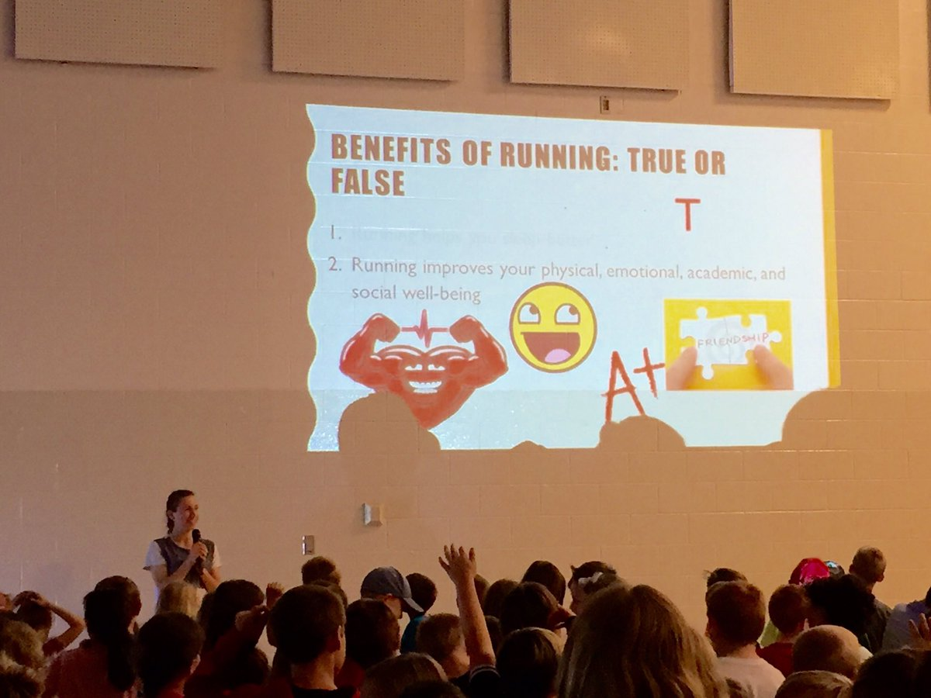
AMA Youth Run Club
YRC CHAMPion Savanna Boutin gives a school health advocacy talk to the YRC at Parkland Village School.

Slide 18
AMA Youth Run Club
Interested in volunteering with the AMA YRC?
Contact Hayley Degaust, Provincial Projects Coordinator, EAS, to:
Get connected with a YRC school
Find out if a school in your area has a YRC (EAS can facilitate program set-up)
hayley@everactive.org | 780-454-4745

Slide 19
AMA Youth Run Club
YRC CHAMPion Resources
AMA website (How can I get involved with the AMA YRC?) albertadoctors.org/YRC
7 School Health Advocacy Talk tip sheets
Video: Tips for engaging elementary school students in the AMA YRC
EAS website amayouthrunclub.com
  Coach’s Corner: Runner and Coach Handbooks; Physical Activity Guide; Running Log; How to Host a Fun Run Guide; and more

Slide 20
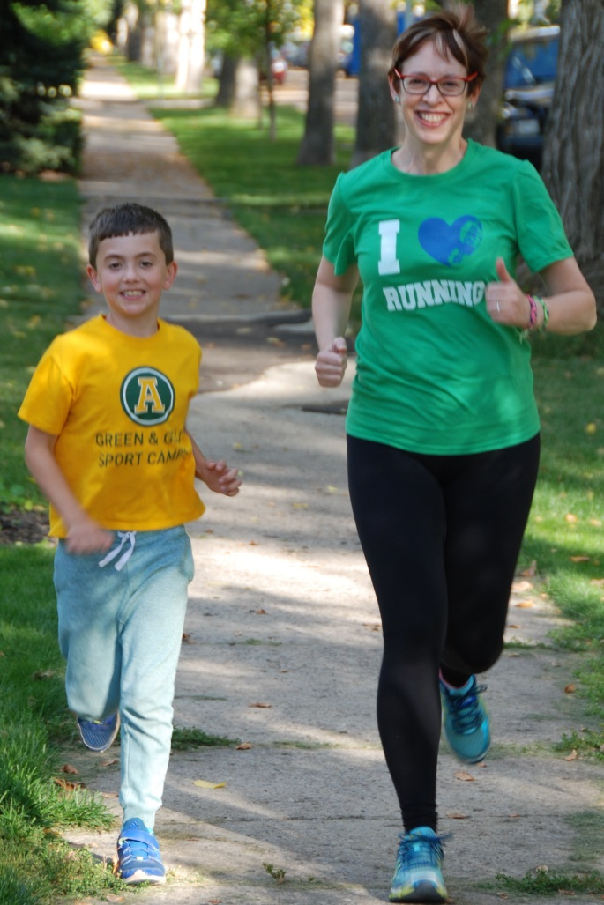
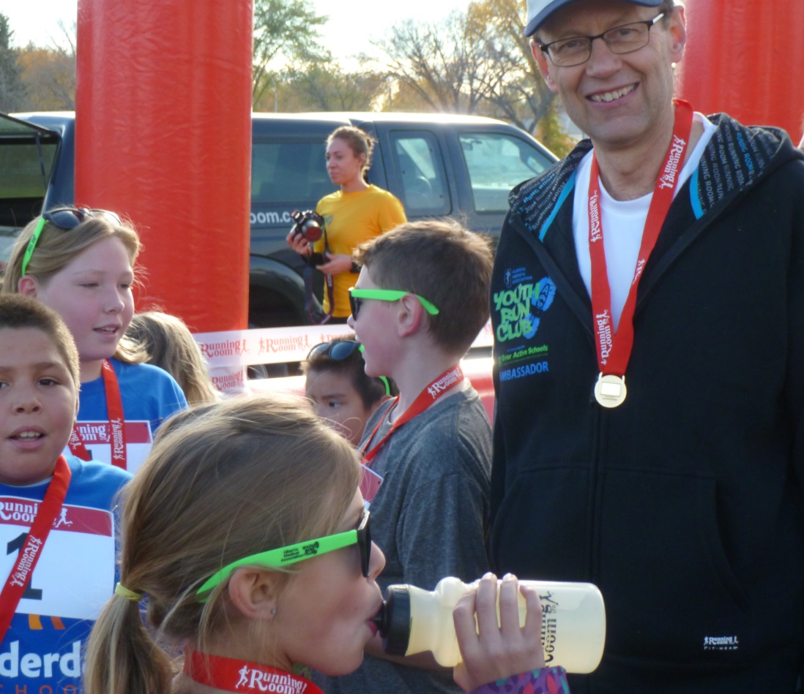
AMA Youth Run Club
The Smiles of YRC CHAMPions
Dr. Kelly, running with her son, Alex
Dr. Nohr with Lauderdale Elementary students; fall 2015 launch, Edmonton

Slide 21
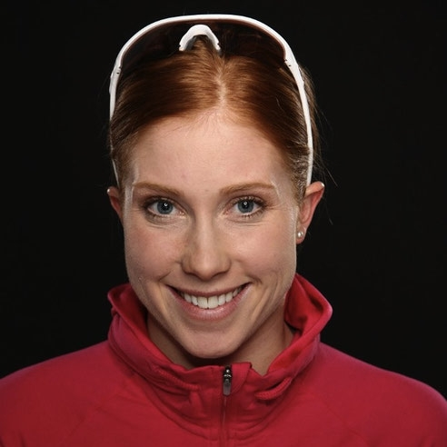
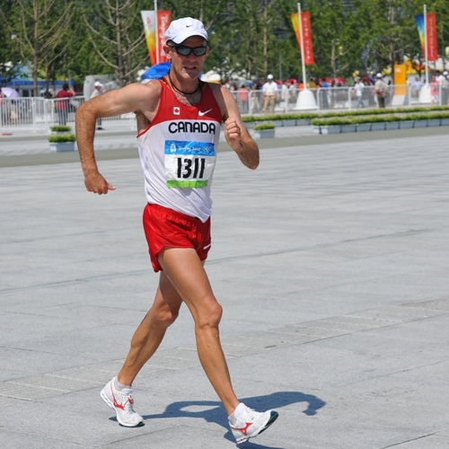
AMA Youth Run Club
Ambassadors
Paula Findlay
Canadian Triathlete
2012 Olympics
Tim Berrett
Canadian Race Walker
1992-2008 Olympics

Slide 22
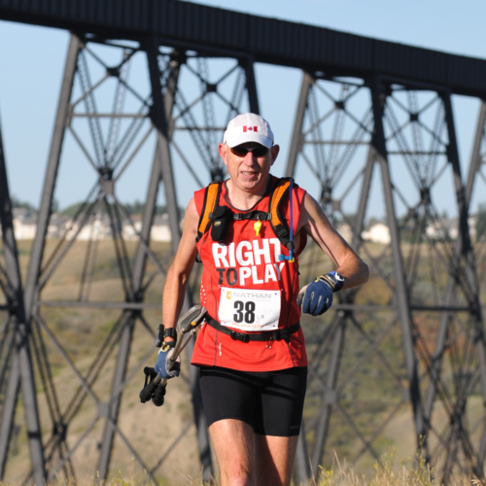
AMA Youth Run Club
Martin Parnell
Ultra-Marathoner/5-time Guinness World Record Holder

Slide 23
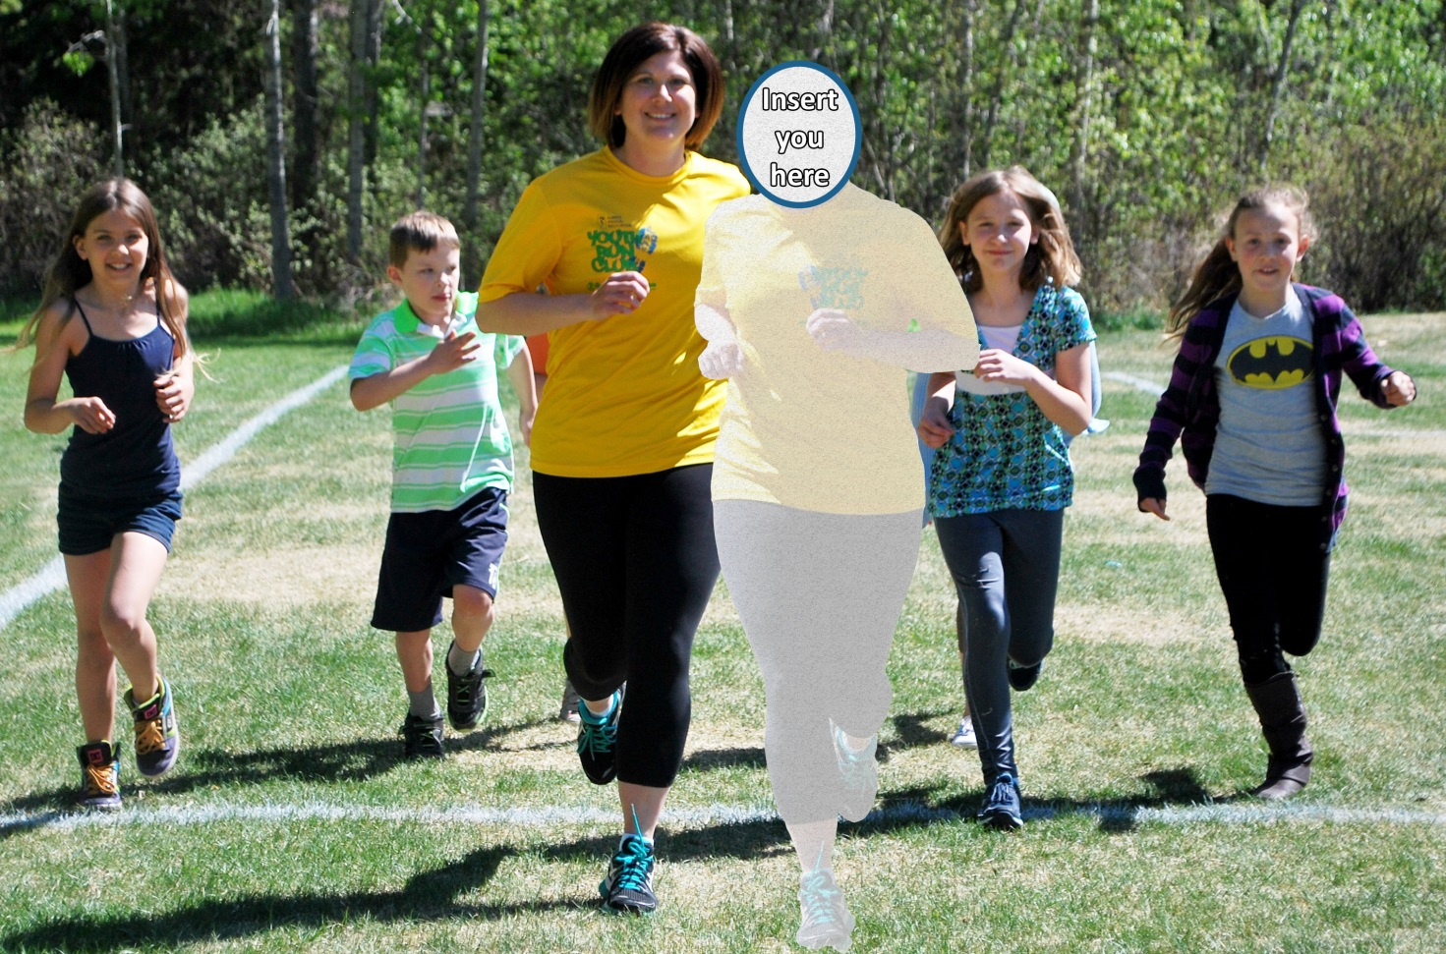
AMA Youth Run Club
We have the schools, the kids, sponsors, ambassadors ... All that’s left is … YOU!

Slide 24
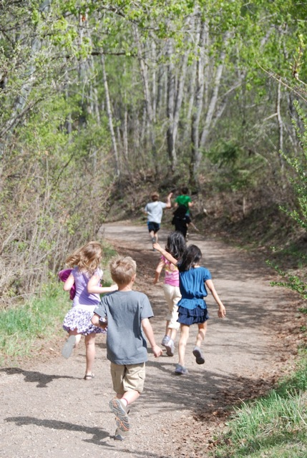
AMA Youth Run Club
Thank you!
Jodi-Ann Sadler, Coordinator, Professional Affairs, AMA
Jodi-ann.sadler@albertadoctors.org
Vanda Killeen, Senior Communications Consultant, Public Affairs, AMA
Vanda.killeen@albertadoctors.org
albertadoctors.org/YRC
Hayley Degaust, Provincial Projects Coordinator, Ever Active Schools
Hayley@EverActive.org
Amayouthrunclub.com

